Slide 1

FAPI and all that
Prof John Buscombe

Slide 2
Introduction
FAPI
FES
Other agents

Slide 3
What is FAPI
FAPI=fibroblast activation protein inhibitor
Related to fibrosis
Fibrosis is a healing reaction to any injury such as infection or infarct
Can also be a major component of auto-immune disease
Can result in organ failure
Some tumour cells induce fibrosis as part of support

Slide 4
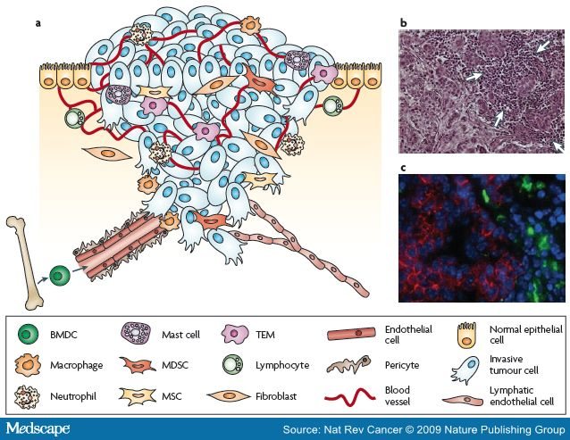
What is in a tumour-revision

Slide 5
FAPI imaging
Started about 40 years ago
Concentrated on inflammation and infection
Labelled with single photon agents
Did not get used widely
However, some cancers also produce cancer chemokines which develop cancer activated fibroblasts
Also sarcomas are cancers of fibroblast cells lines

Slide 6
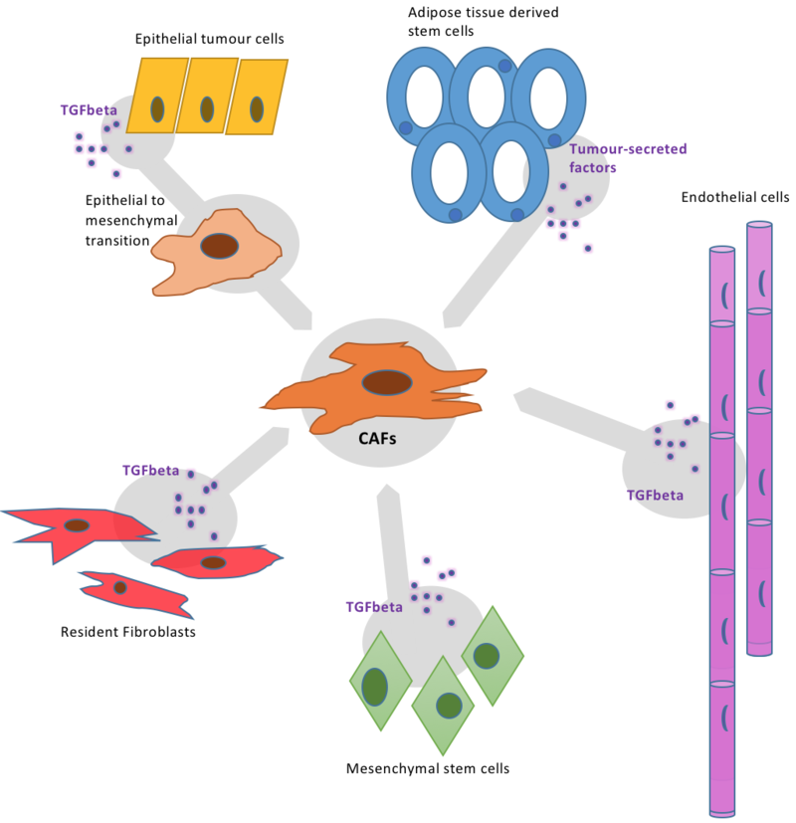
Cancer induced fibrosis
A variety of cancer chemokines have been identified
Tenascin-C in muscle and brain
Desmin in NETs
FAP itself
Fibroblast specific protein-1
J Semin Cancer Biol 2014

Slide 7
The breakthrough-Ga-68 FAPI
Giessel et al JNM 2019
Use of Ga-68 DTPA labelled fibroblast activation protein inhibitor (FAPI)
Present in the support structure of most tumours
Hope this will be more cancer specific than FDG
Less non specific background activity

Slide 8
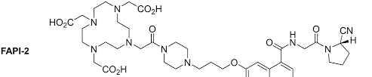
Ga-68 FAPI-2 structure
Simple structure which can be added to a ligand for Ga-68 or possibly fluorinated with F-18

Slide 9
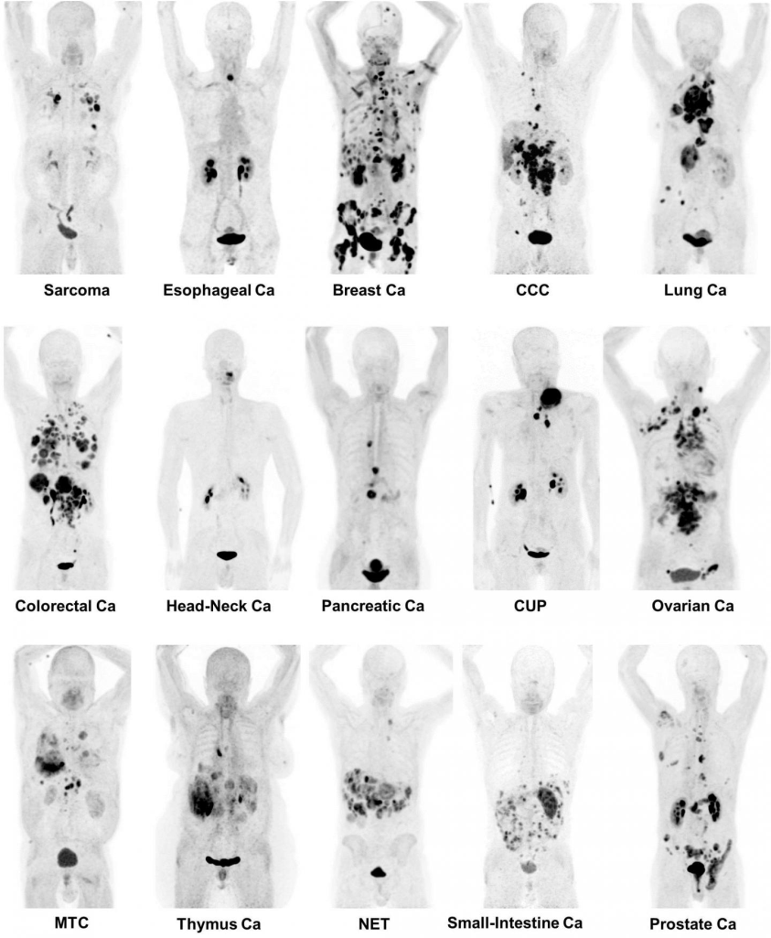
SNMMI picture of the year 2019

Slide 10
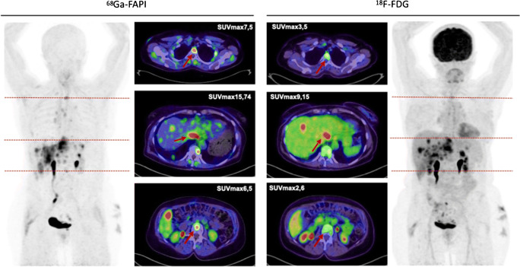
Ga-68 FAPI in gynaecological cancer
Study by Dendl at al EJNMMI 2021
Looked at 167 women with endometrial, ovarian and breast cancer in Germany
Correlation with known sites of disease
Main advantage is better T/B ratio in areas like liver and chest
63 year old female with metastatic breast cancer

Slide 11
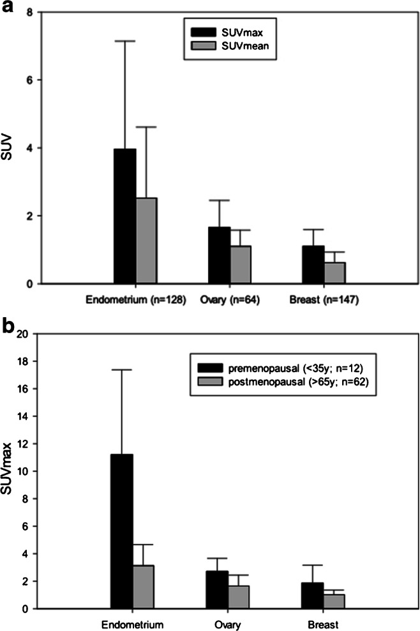
Variation in FAPI uptake
In review of 167 women with gynae or breast cancer noted variation of FAPI uptake
Note menopausal status important for example minimal uptake of Ga-68 FAPI in post menopausal breast cancer

Slide 12
Ga-68 FAPI in gastric cancer
Meta-analysis of Ga-68 FAPI in gastric cancer
Ruan et al Theranostics 2023
Looked at 14 studies of 527 patients, 358 with gastric cancer
Pooled sensitivity 84% and specificity 88%
However no prospective trials and though F-18 FDG quoted not the same patients in many trials

Slide 13
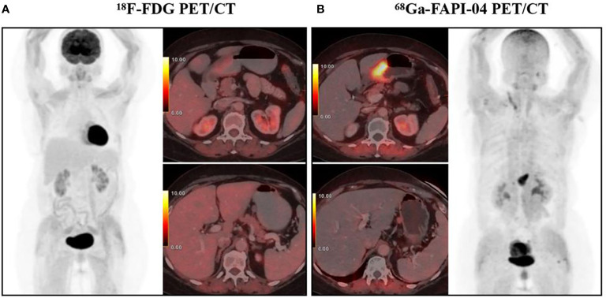
Ga-68 FAPI PET in GI tumours
Yang et al Fron Oncol 2022
Imaged 36 patients with GI tumours in Nanjing China
Identified tumours not seen on FDG
Noted low background in normal liver

Slide 14
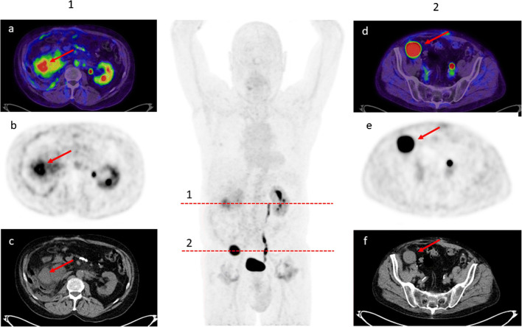
Ga-68 FAPI in sarcoma
Sarcomas are connective tissue tumours
Cell lines are fibroblast like
Therefore could be good target for Ga-68 FAPI
Koerber et al imaged 15 sarcoma patients in Germany EJNMMI 2021
Very high uptake of Ga-68 FAPI in metastatic liposarcoma SUVmax=15

Slide 15
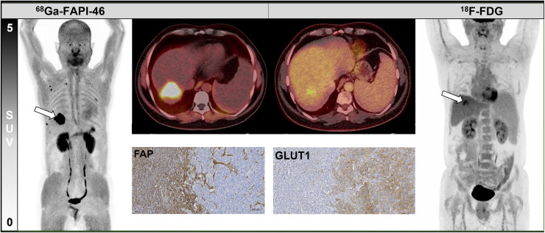
Ga-68 FAPI in cholangiocarcinoma
Cholangiocarcinoma is a diagnostic problem
Often small
Have low uptake of FDG
Within liver with high background
Maybe a good target for Ga-68 FAPI
Pabst et al JNM 2023
10 patients from Germany
Cholangiocarcinoma seen with FAPI and FDG imaging with clearer uptake of FAPI

Slide 16
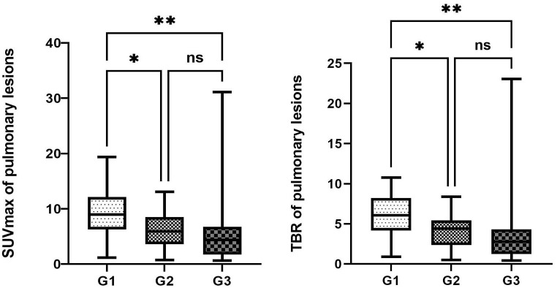
Ga-68 FAPI in lung pathology
Xie et al Fron Oncol 2024
Retrospective review of Ga-68 FAPI uptake in lung pathologies in 99 patients in China
Large range in all pathologies
Highest mean SUVmax in lung primaries
G1 Primary lung cancer
G2 Metastaic tumour in lungs
G3 Benign lesions

Slide 17
Ga-68 FAPI vs F-18 FDG
Prospective study by Ballal et al
Centres in India, Germany and Chile
45 patients with various cancers imaged with both agents
A non significant increase in lymph node metastases seen with Ga-68 FAPI compared to FDG
No significant difference in SUV

Slide 18
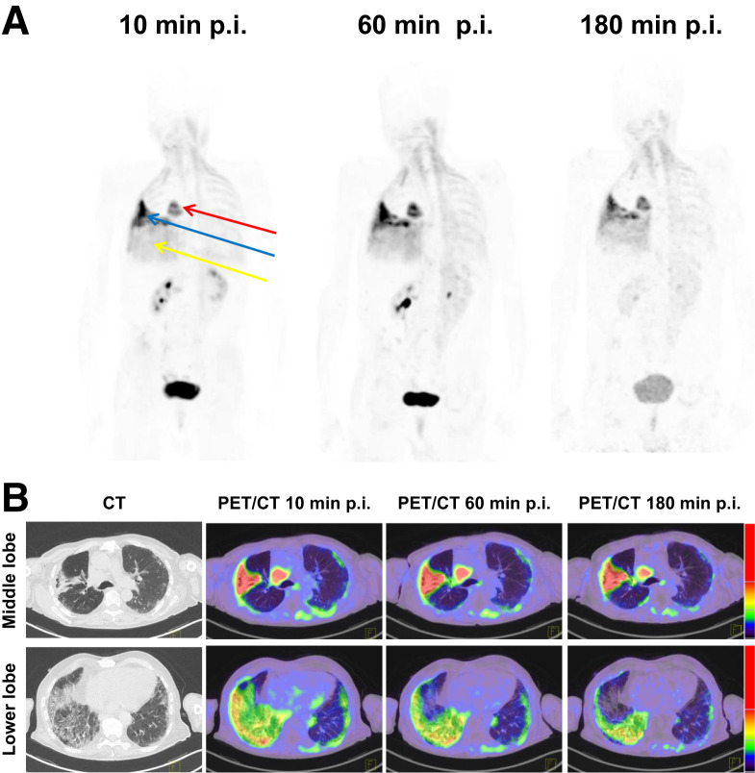
Ga-68 FAPI PET in lung fibrosis
Idiopathic lung fibrosis is a rare but deadly disease
When CT abnormal there is irreversible lung damage
Ga-68 FAPI PET offers the possibility of early detection
Rohrivh et al JNM 2022 Imaged 3 patients in Germany with early lung fibrosis
Rosencrans et al EJNMMI

Slide 19
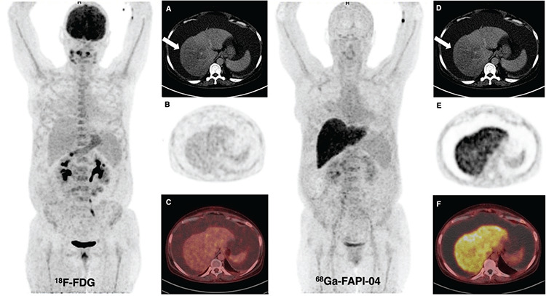
Ga-68 FAPI in liver cirrhosis
Tatar et al Mol Imag RadioTher 2023
Reports 3 patients in Turkey
All had cirrhosis
Ga-68 FAPI shows marked uptake in cirrhotic liver

Slide 20
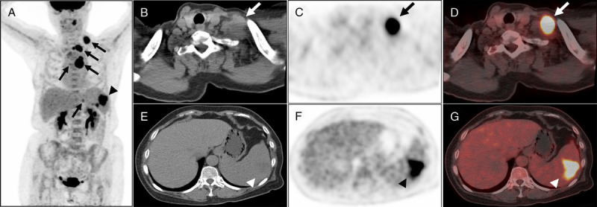
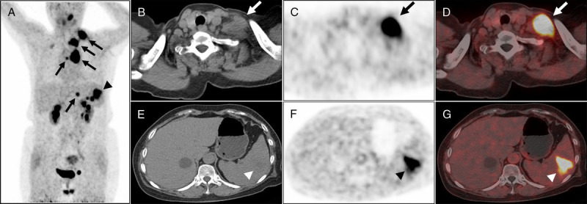
Ga-68 FAPI in infection
Not much data
Makes sense in chronic infection with fibrosis
Case report by Gu et al from China Clin Nuc Med 2020
Good Ga-68 FAPI uptake in TB
F-18 FDG
Ga-68 FAPI

Slide 21
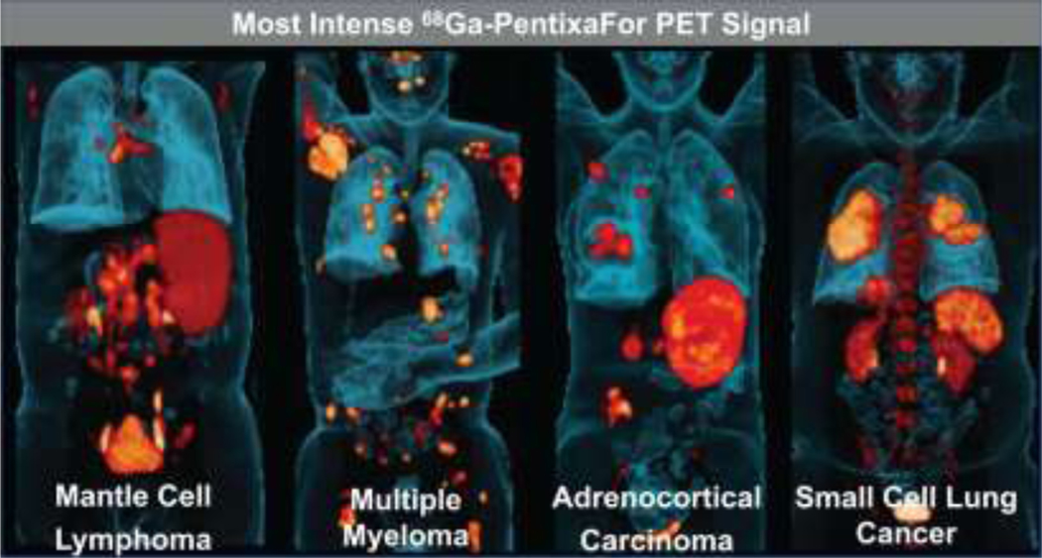
Ga-68 Pentixifor
Ga-68 Pentixifor binds to CXCR4 a cytokine found on mammalian cells
High expression of CXCR4 in cancer cells with metastatic potential
Uptake also seen in IBD, atherosclerosis and Conn’s tumours
Buck et al JNM 2022

Slide 22
Oestrogen receptor imaging
Though FDG is very useful in breast cancer there can be inflammation caused by treatment
Oestrogen receptors mean good prognosis
However, genetic drift in mets mean even if primary ER positive mets may not be
Could biopsy and stain every site of disease
Maybe easier to perform whole body ER imaging with fluoro-estrodiol (FES) PET

Slide 23
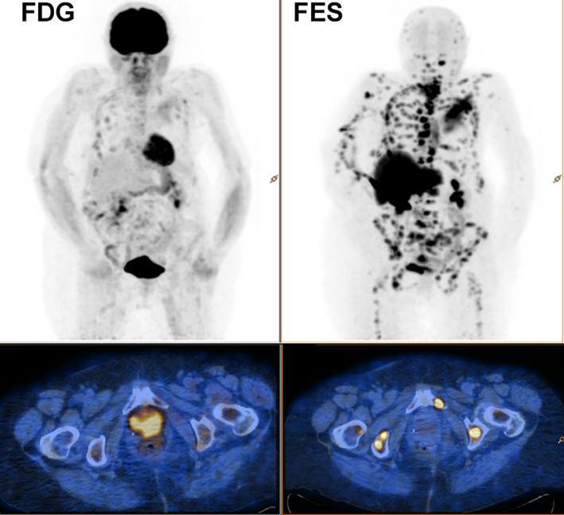
FES vs FDG in Ca Breast
Kurland et al Oncologist 2020

Slide 24
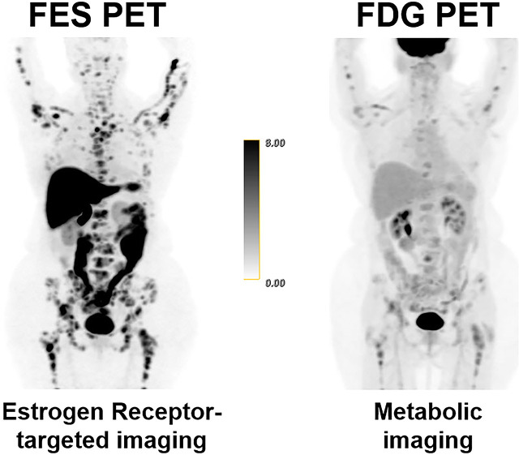
Good in lobular breast cancer
Lobular breast cancer can be slow growing
Often presents with odd site metastases
FDG imaging may be low due to low metabolic rate
Normally ER positive
Trial run at Sloan Kettering (Ulaner et al JNM 2021

Slide 25
Oestrogen receptor PET
Licenced and available in the USA
Still not clear how it will be used clinically
Also unclear how clinician may use this information to change patient management
Not yet available in Europe

Slide 26
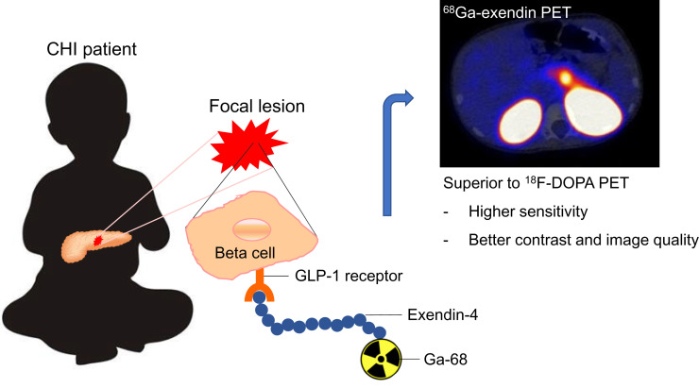
Imaging the pancreas
Exendin is a glucagon like protein-1 receptor agent
Can be used to image pancreatic beta cells
These may be focal in insulinoma or congenital hypoglycaemia
Both rare conditions
European multicentre trial Boss et al JNM 2022

Slide 27
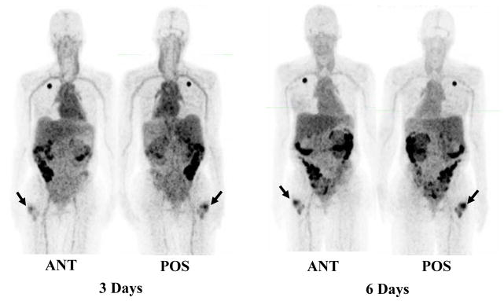
Zr-89 Herceptin
Zr-89 is a long-lived PET pharmaceutical
Can be complexed to a number of molecules
Used with antibodies as can image over 24 hours
Work done at Uni of Washington LaForest etal Mol Imag Biol

Slide 28
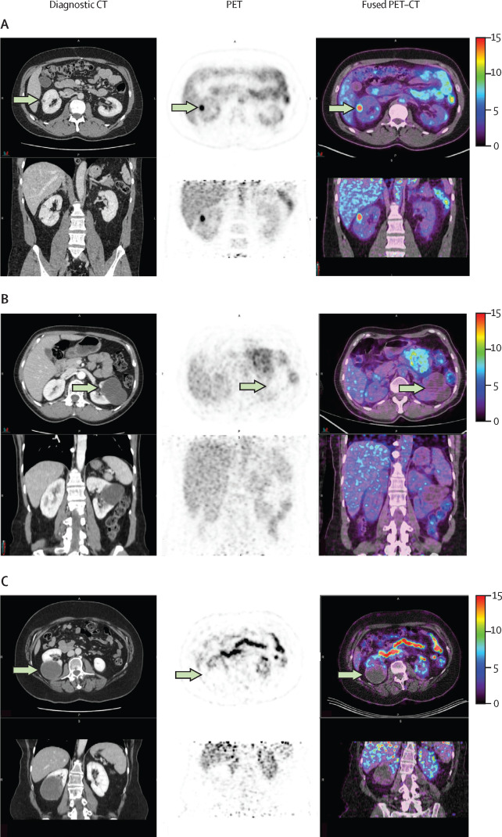
Zr-89 immunoPET in renal cancer
Phase III prospective multi-centre trial
Used Zr-89 gerentuximab
Labes cyclic anhydrase 9 present in RCC but not normal renal tissue
PET imaging 5 days after 37MBq given
Sensitivity 86%, specificity 88% for primary and mets
Shuch et al Lan Oncol 2024

Slide 29
Summary
FAPI is good when its good
Does not target tumour but support system
UNLESS it’s a sarcoma
Looks good in cholangiocarcinoma and other GI tumours
Used in inflammation
FES maps oestrogen receptors
Many more PET products coming

